Slide 1
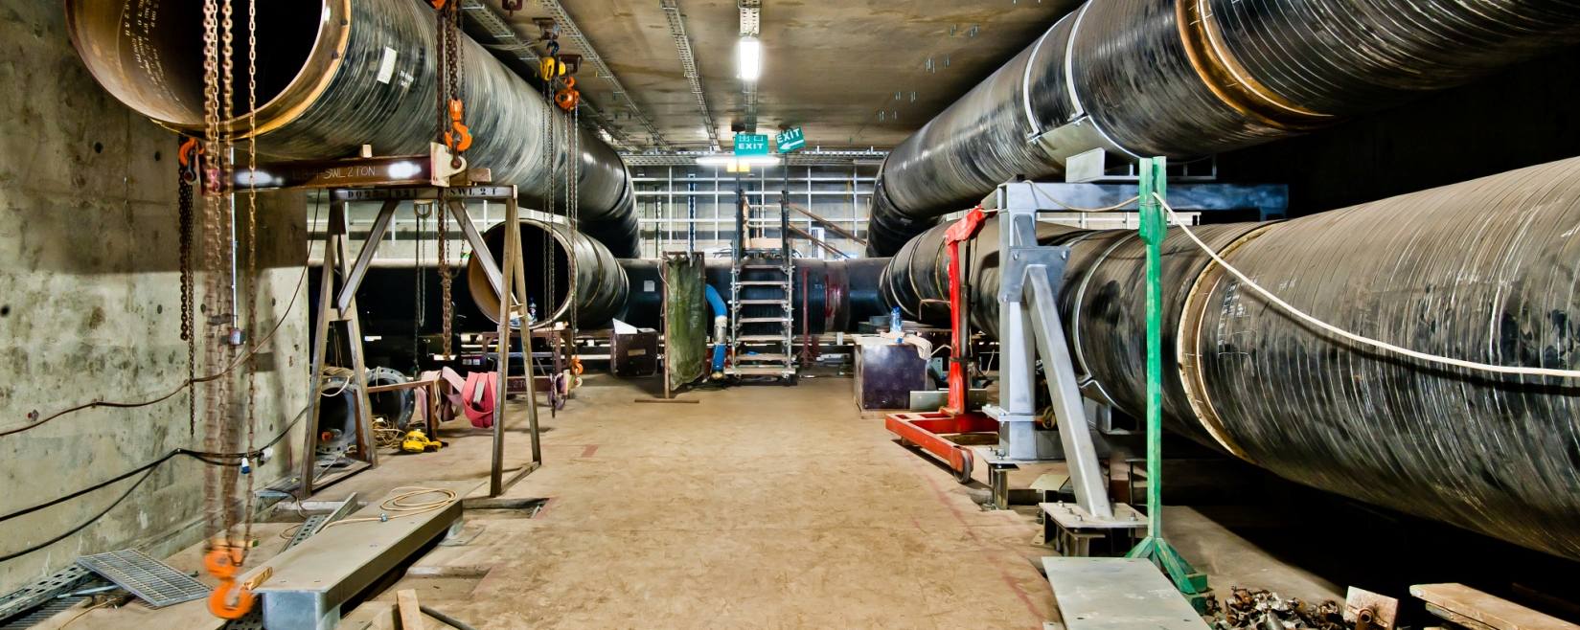
WiMax Network - RAN Site and Core Site Engineering
Location | Bahrain
Division | Power
Duration | 10 months
Background
WiMax or Worldwide Interoperability for Microwave Access provides a robust, reliable, and cost effective means to deliver broadband services in metropolitan and rural areas. Menatelecom deployed and managed a nationwide 802.16e-based mobile WiMAX and IP Multimedia Subsystem (IMS) network in the Kingdom of Bahrain. The project aimed at delivering wireless broadband connectivity and advanced data services to both business and residential customers across the kingdom.
Services
RAN (Radio Access Network) of the WiMax network which includes Site Acquisition, building cell sites, designing frequency plan, selecting antennas and network optimization. Irinatech has a strong understanding of the specific requirement of Bahrain and is experienced in overcoming the challenges in achieving the goals of developing the RAN network.
Roof top towers and greenfield towers, based on the need of landscape where these telecommunication structures were to be installed, were designed and deployed by our team of Engineers.
45m | Lorum eta ipsum
30% | Lorum eta ipsum
50* | Lorum eta ipsum

